Slide 1
Automated Plant Watering System with Servo Motor Under Guidance of Prof. Dr. Matthias F. Wagner
GROUP 1
Hussam Alfaki
Hemanth Kumar Babu
Thomas Belser
Sebastian Luelow

Slide 2
INTRODUCTION
Intelligent Automation is a key necessity
Finding the right amount of water to irrigate .
Wrong amount can lead to flooding , water logging or dry state.
We have used V model for our project

Slide 3
REQUIREMENT ANALYSIS
1. Functional Requirements:
System can operate in manual as well as automatic mode
2. Software requirements:
Platform: Windows10(64 Bit)
Calculation of water is accurate based on present scenario
Amount of water irrigated is accurate based scenario in the pot.
The plant is not over or less irrigated
The right plant is irrigated
Monitor plant regularly and update GUI.
Programming Language: Java,C
Tools: IntelliJ,Xterm,Rstudio,Atmel.
Repository: GitLab
Documentation: Latex

Slide 4
MATHEMATICAL MODEL
The model has basically taken into consideration parameters such as:
C _{lambda} : Latent heat of evaporation
E_{T} : The rate of transpiration
V_{SR}: The amount of radiation in the environment
V_{VPD}: Vapour pressure deficit which given by (Sat Vapour pressure – Actual Vapour pressure )
C_{A} , C_{B}: Coefficients dependent on plants
The equation for transpiration over time ‘t’ is given by,
C _{lambda} E_{T} = V_{SR}C_{A} + V_{VPD}C_{B}
Substituting the value of constants we reduce the equation to
X_{ET} = V _{SR} *.5+V_{VPD}*8.5
40

Slide 5
MATHEMATICAL MODEL(Cont..)
Read all the sensor values from the serial console
Check present water level in the pot . Get deficit water (in next 30mins)= required water- present water level
To calculate the amount of time the value to be open
Divide the amount of deficit water by flow rate to get time for valve closure
Convert all the values to SI units
Calculate Transpiration then derive the amount of water that will be depleted

Slide 6
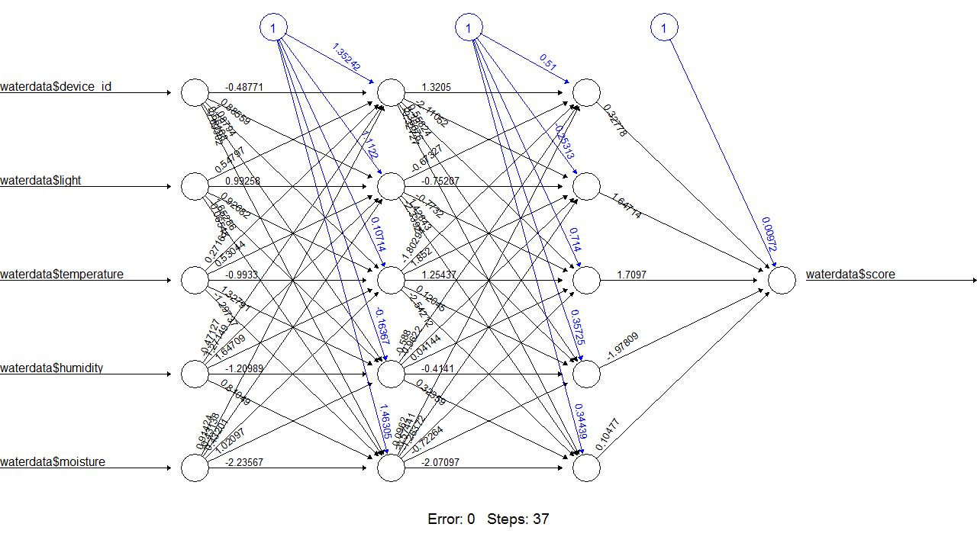
Other approaches
Neural Network
But needs lot of input data
Fig. Neural network of 5 input and 1 hidden layer using RProp

Slide 7
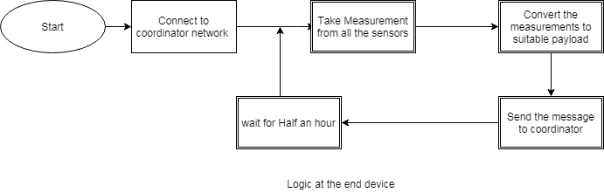
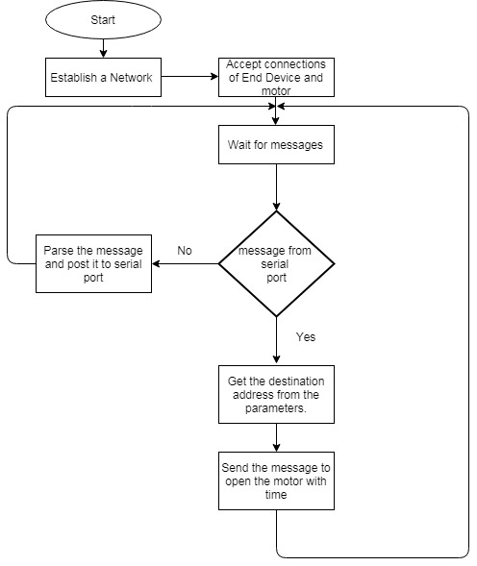
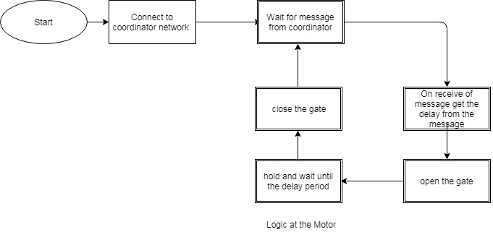
FLOW DIAGRAM Hardware

Slide 8
REFERENCES
[1] Jorge Antonio Sanchez 1, Francisco Rodrguez, Jose Luis Guzman 1 and
Manuel R. Arahal. Virtual Sensors for Designing Irrigation Controllers
in Greenhouses.
http://www.mdpi.com/1424-8220/12/11/15244/pdf
sensors, 2014. ISBN 1424-8220.
[2] http://biomet.ucdavis.edu/biomet/VPD/vpd.htm
[3] http://www.dartmouth.edu/~ears5/handouts/heat.html
[4] http://ccc.atmos.colostate.edu/~coagmet/extended_etr_about.php
[5] http://www.1728.org/flowrate.htm
[6] http://emant.com/316002.page

Slide 9
THANK YOU
GROUP 1
Hussam Alfaki
Hemanth Kumar Babu
Thomas Belser
Sebastian Luelow

